Slide 1




--SIGNAL LOST--
December 21th 2023
--SIGNAL LOST--
--SIGNAL LOST--
Baptiste PERRIN – 1st year Game Design & Team Leader
Loïc VAREILLES – 1st year Game Design
Adrien LECHAT – 1st year Game Programming
Florian MARTINS – 1st year Game Programming
Hortense MARIE – 1st year Game Programming
Killian FURNO – 1st year Game Programming
01/36

Slide 2

Reminder
Create a Gamebook
C++ Programming Language
No Sound (exception for our game that professors accepted)
No Art
6 Weeks
2 Game Designers and 3-4 Game Progammers
02/36

Slide 3
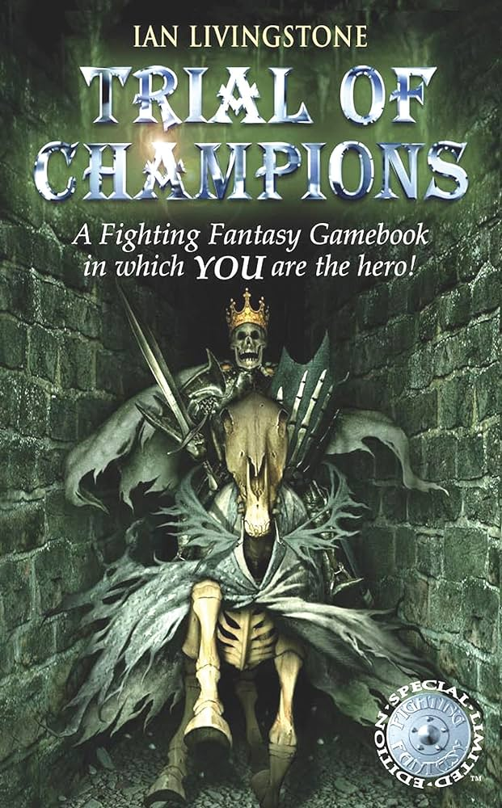
What is a Gamebook?
Video game version of the choose-your-own-adventure books
Make Choices that affect the story
It's a interractive stories with text and illustration
Fixed plot and limited endings
Explore different paths and scenarios
03/36
Notes:
-genre de livre nédans les années 1960
-popularisé par les série des "défis fantastiques" édités par Gaillmard

Slide 4
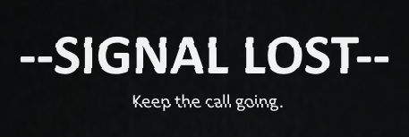
What is our Gamebook?
You recieve the call from a stranger, and you're the only one who can help them
Set on an abandonned island occupied by the ruins of a city
The player is the protagonist’s advisor, who might act on their own
04/36

Slide 5


What experience did we want to make?
Real-time feeling :
Real phone call feeling :
An engaging mystery :
Text pace
Writing methods
Timer
No narrator, only the protagonist
Protagonist evolving depending on your choices
Each end reveals informations
Everything can be explained
05/36

Slide 6


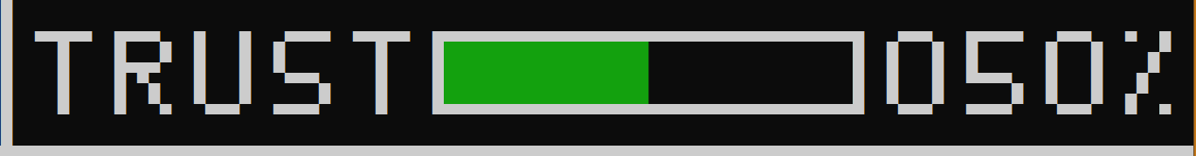
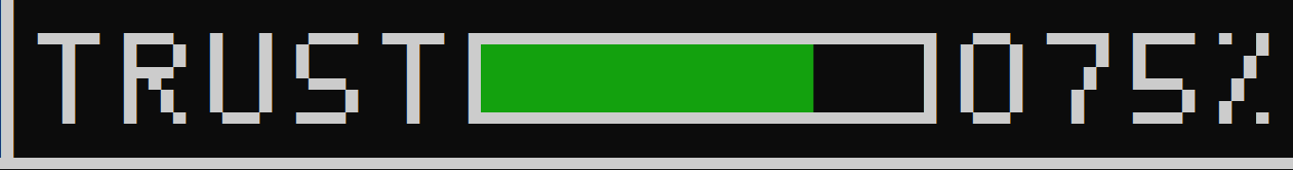
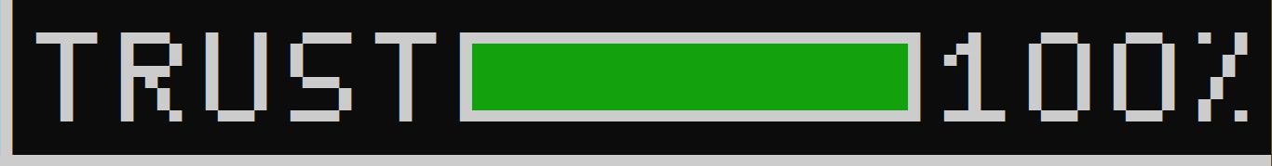
Core Gameplay
Trust bar :
5 different states
Gets higher/lower depending your choices
Opens and closes doors in the story by directing to different scenes
06/36

Slide 7
Core Gameplay
Choice influenced by Trust:
Low trust path
-
Trust check
+
Scene 2
1 - Choice
High trust path
Scene 1
Scene 3
07/36

Slide 8
Core Gameplay
Timer :
Ticks down to zero and sends the player to a default scene
Used in timed events to put the player under pressure
08/36

Slide 9
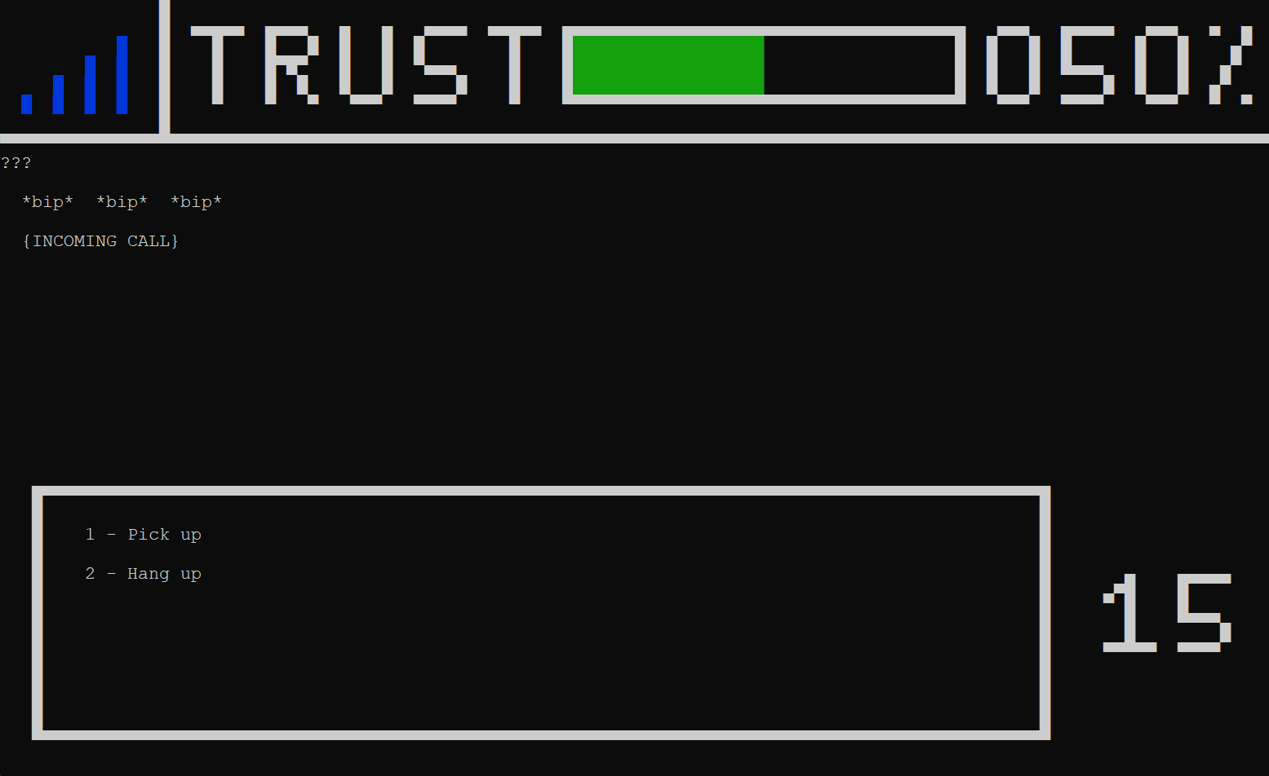
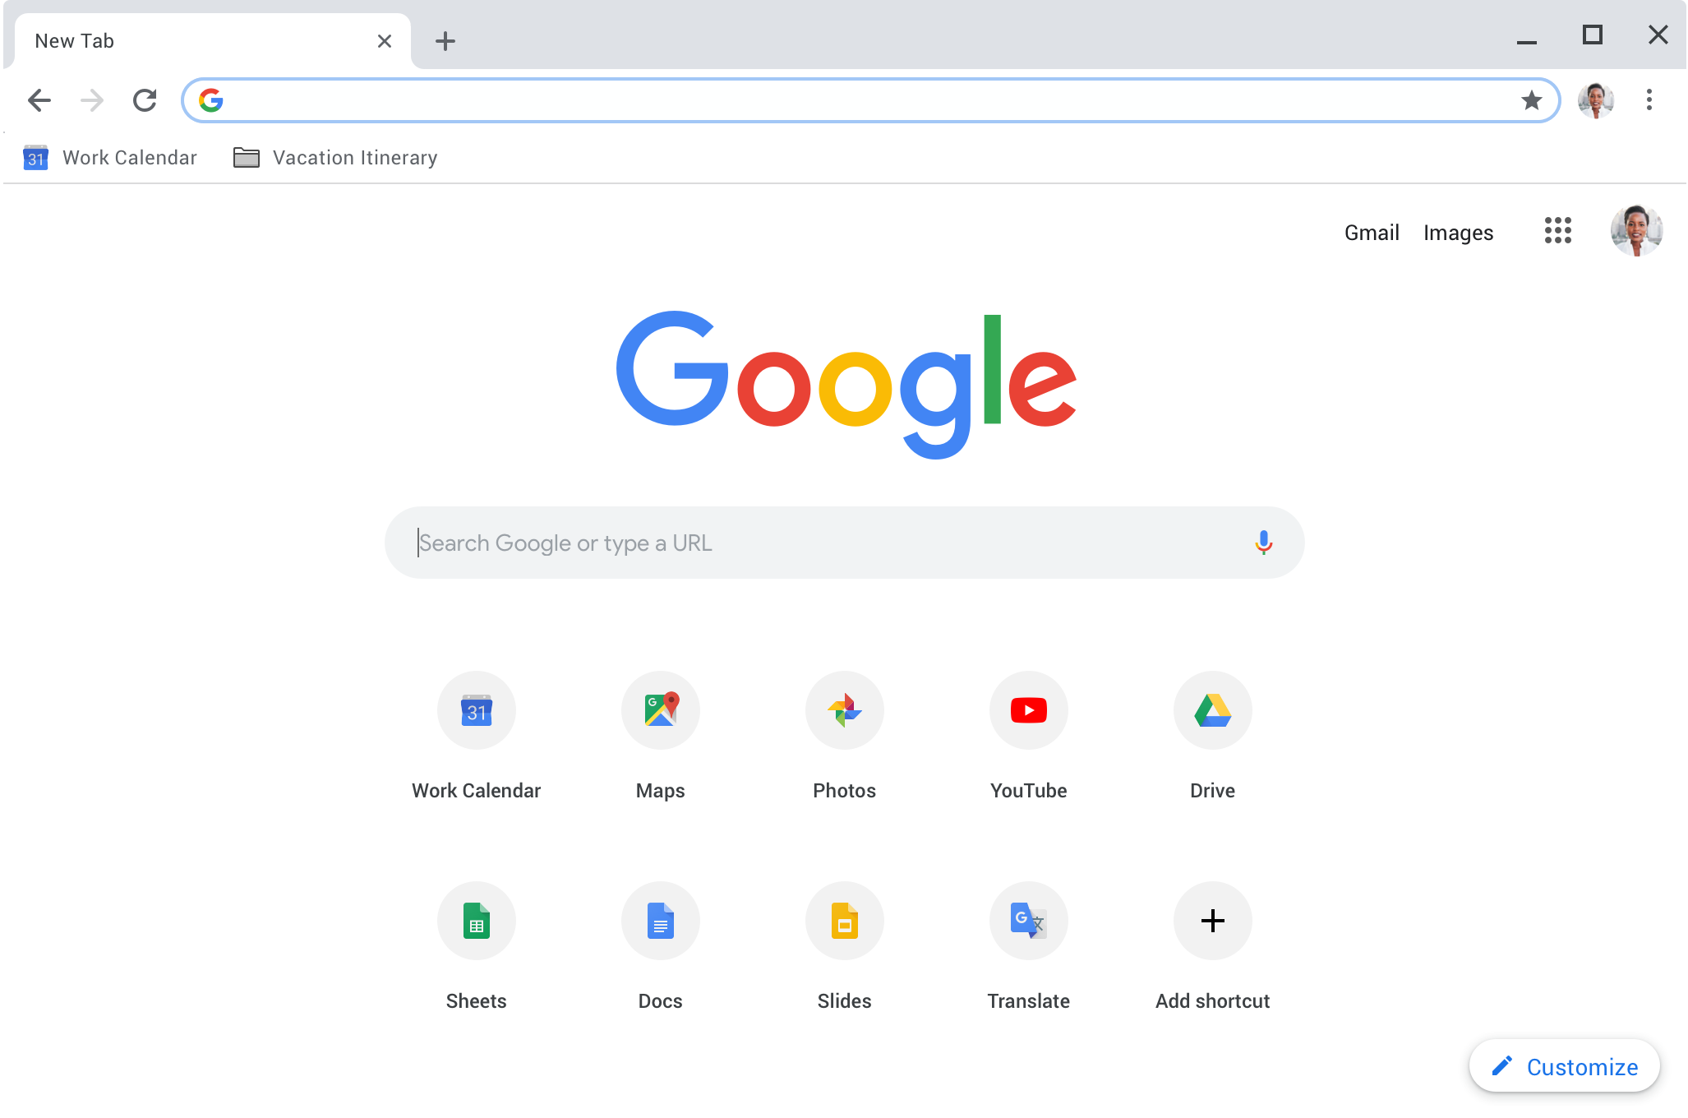

Core Gameplay
Browser Search :
09/36

Slide 10







Tools
Visual Studio 2022
Discord
OneDrive
Trello
Excel
Miro
GitHub
10/36

Slide 11
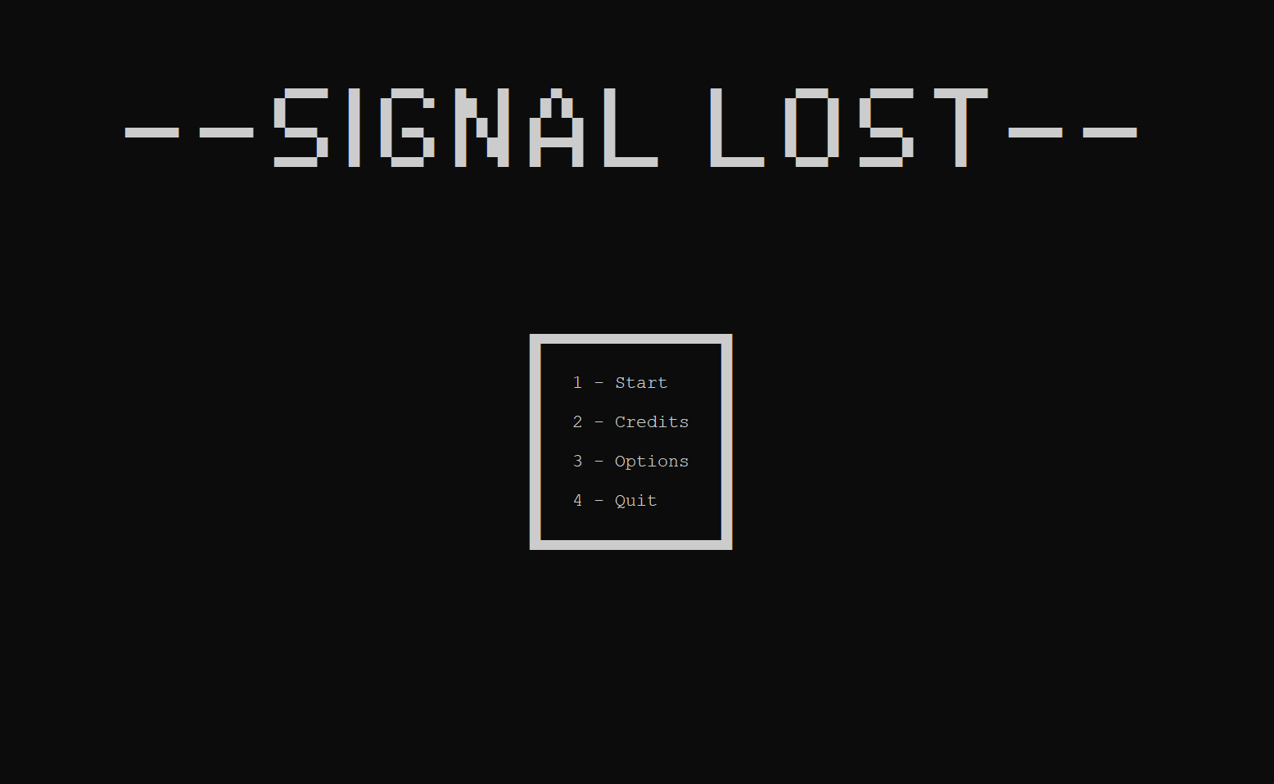
Interfaces Menu
Menu Example :
11/36

Slide 12
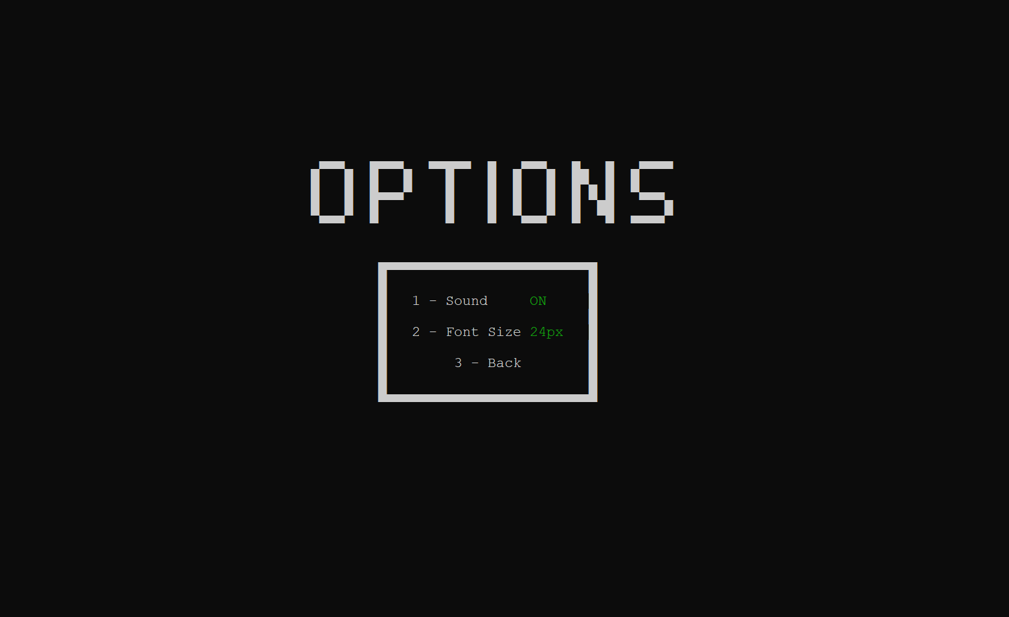
Interfaces Menu
Options Example :
12/36

Slide 13
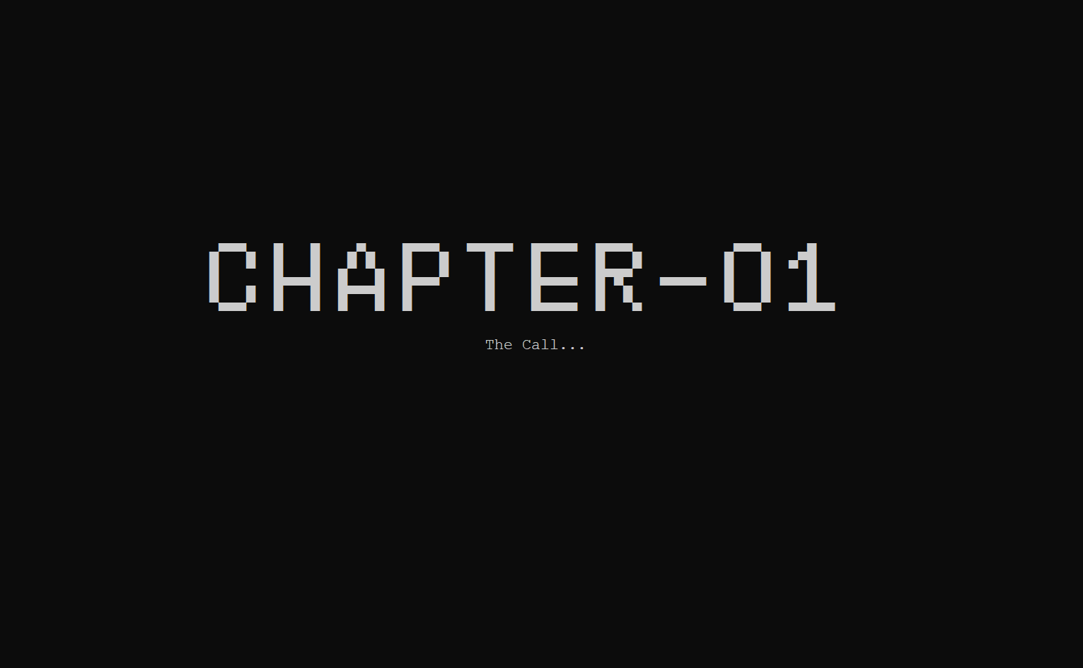
Interfaces In Game
Transition Example :
13/36

Slide 14
Interfaces In Game
Game Example :
14/36

Slide 15
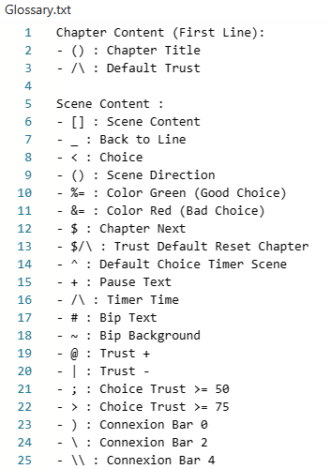
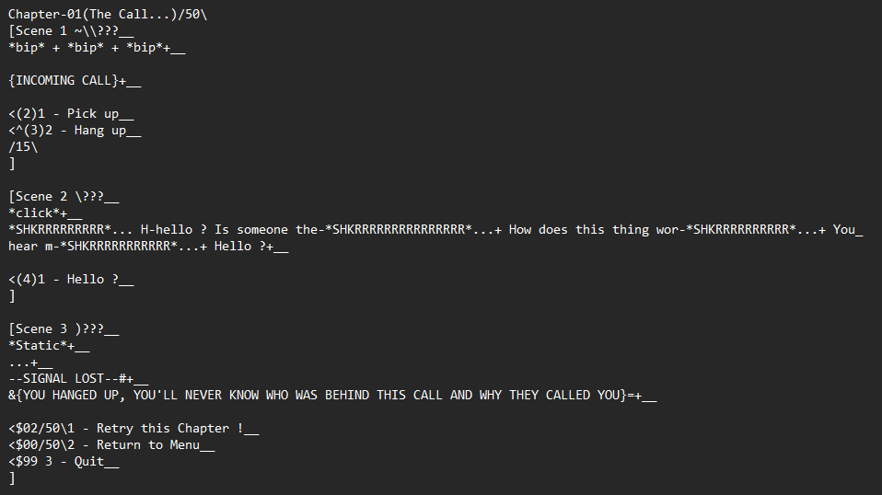
Methodology
Glossary Document :
Chapter Example :
15/36

Slide 16
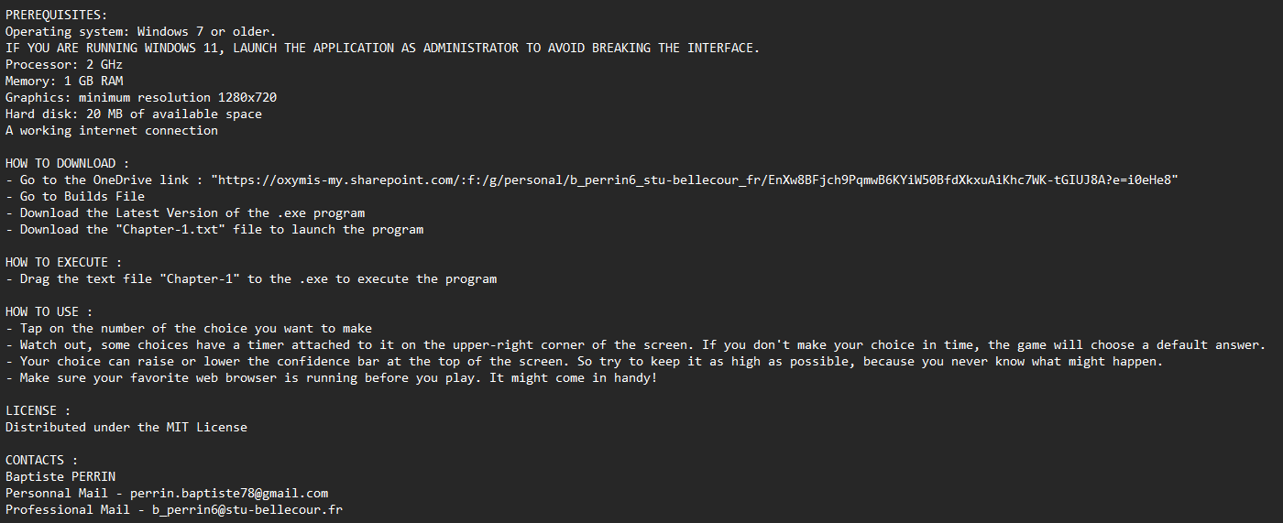
Methodology
README Document :
16/36

Slide 17
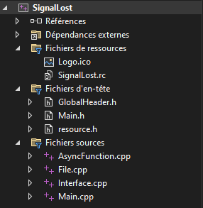
Code Organization
File Hierarchy :
No use of the librairy FTXUI for the interface
17/36

Slide 18
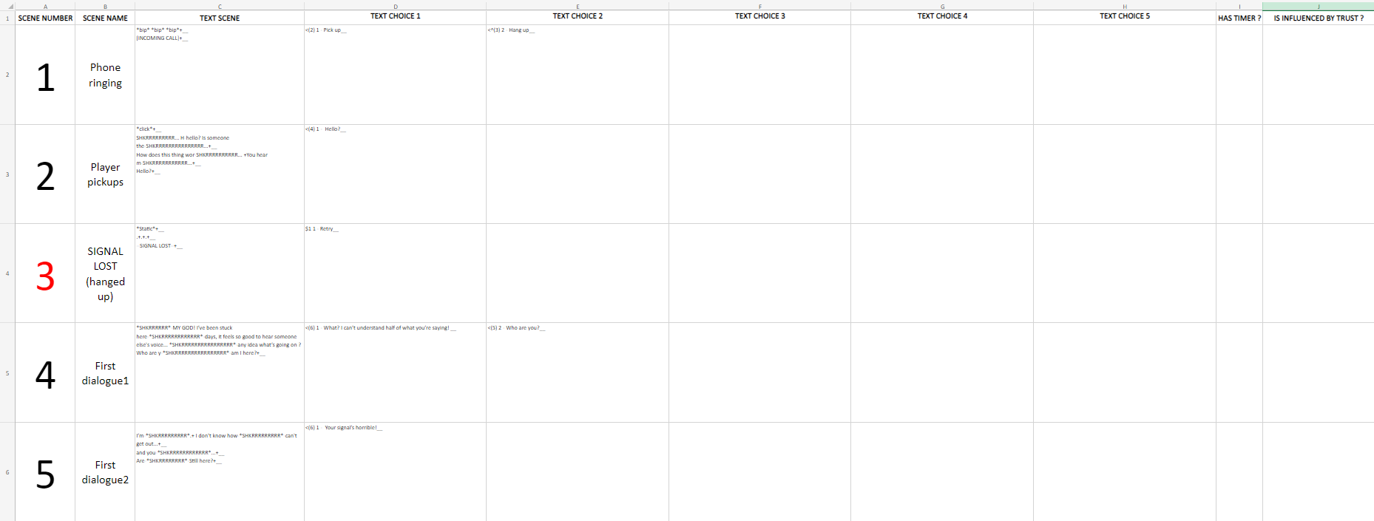

Technical Process
How we write a Chapter :
18/36

Slide 19



Technical Process
How to run a Chapter :
19/36

Slide 20

Technical Process
Chapter Example :
Chapter Composition :
Chapter Number
Chapter Name
Default Trust
20/36

Slide 21
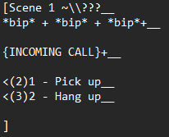
Technical Process
Scene Example :
General Scene Composition :
Scene Number
Scene Name
Label
Choices & Scene Direction
Connexion Bar
21/36

Slide 22
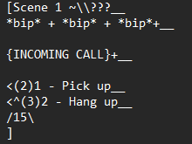
Technical Process
Scene Example :
Timer Scene Composition :
Timer
Default Choice
22/36

Slide 23
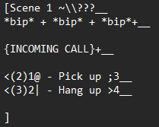
Technical Process
Scene Example :
Trust Scene Composition :
Trust Increase or Decrease
Choice need Trust
23/36

Slide 24
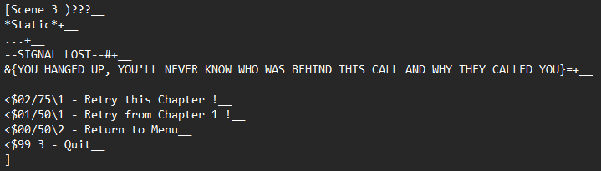
Technical Process
Scene Example :
Choice Chapter Composition :
Chapter Direction
Reset Default Trust
24/36

Slide 25
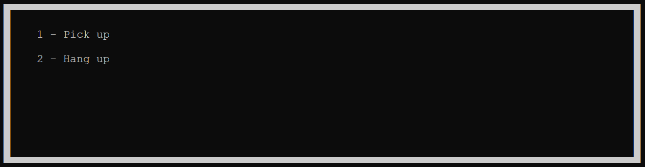
Technical Process
Scene Choice Example :
Press the Choice Number
25/36

Slide 26


Maniability
Glossary Document :
Text color
Pause in the text
Timer time
Scene names
Connection bars
Beep sound
26/36

Slide 27
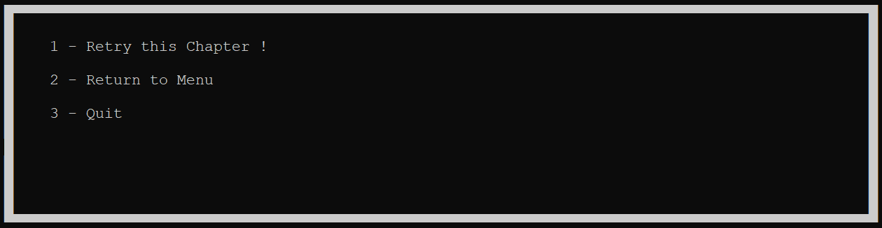
Gameplay
Gameplay length / Replayability :
About 1-2 hours of Gameplay
27/36

Slide 28
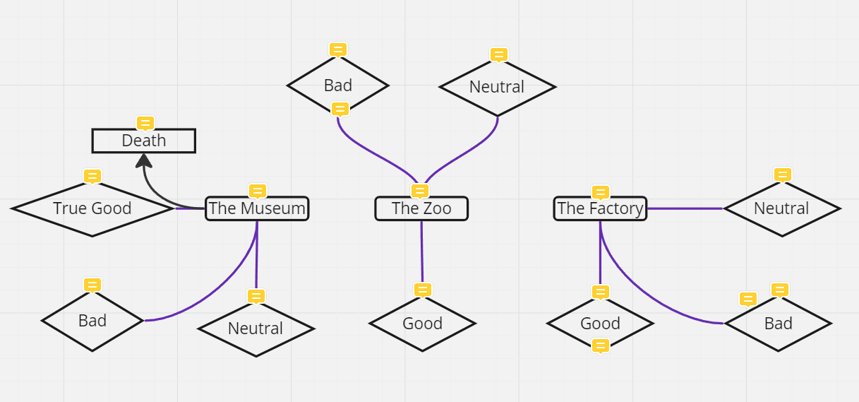
Content of the Game
4 Chapters:
1 Intro chapter
3 Chapters to choose from for the rest of the adventure
450+ Scenes
9 Ends:
3 Good Endings
3 Bad Endings
3 Neutral Endings
Multiple Game Over
1000+ Lines
28/36

Slide 29
Organization
Approximately one meeting per week on Discord
Lots of testing and playtesting sessions
We added features as the project progressed
29/36

Slide 30
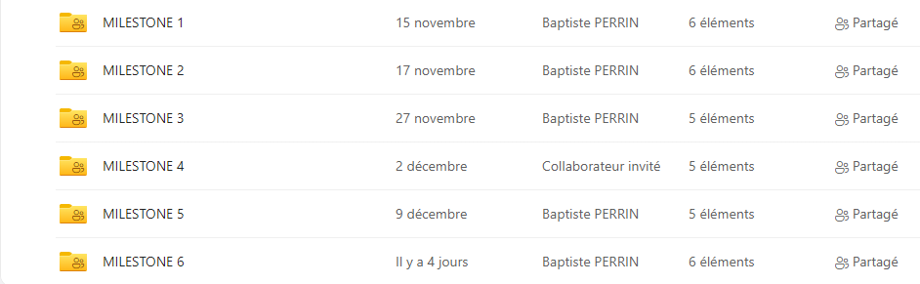
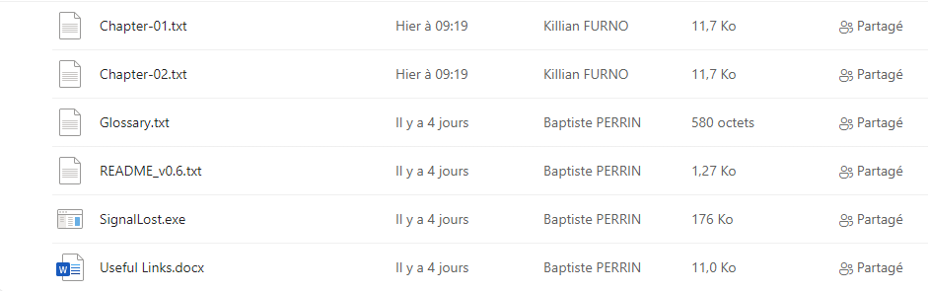
Organization
Milestone Examples :
30/36

Slide 31
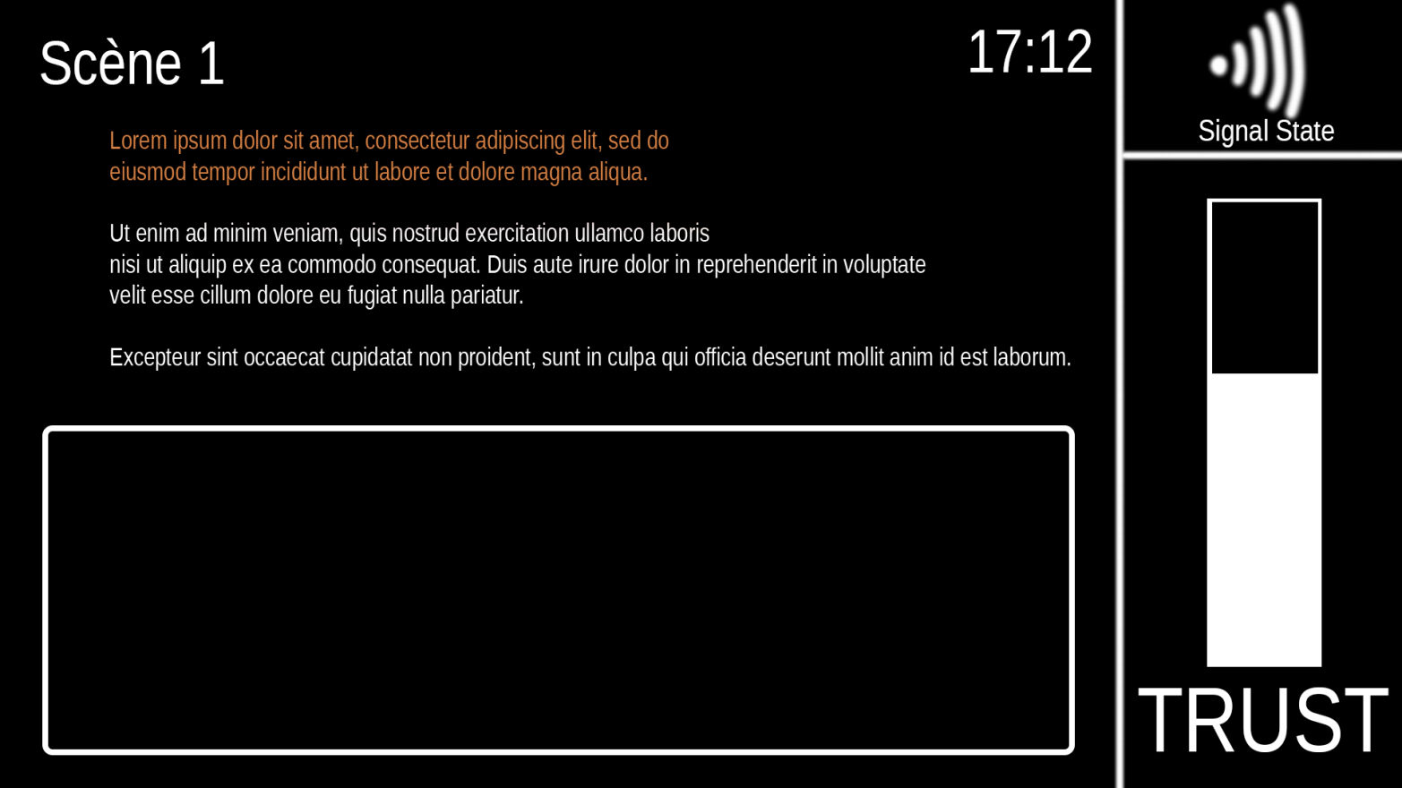
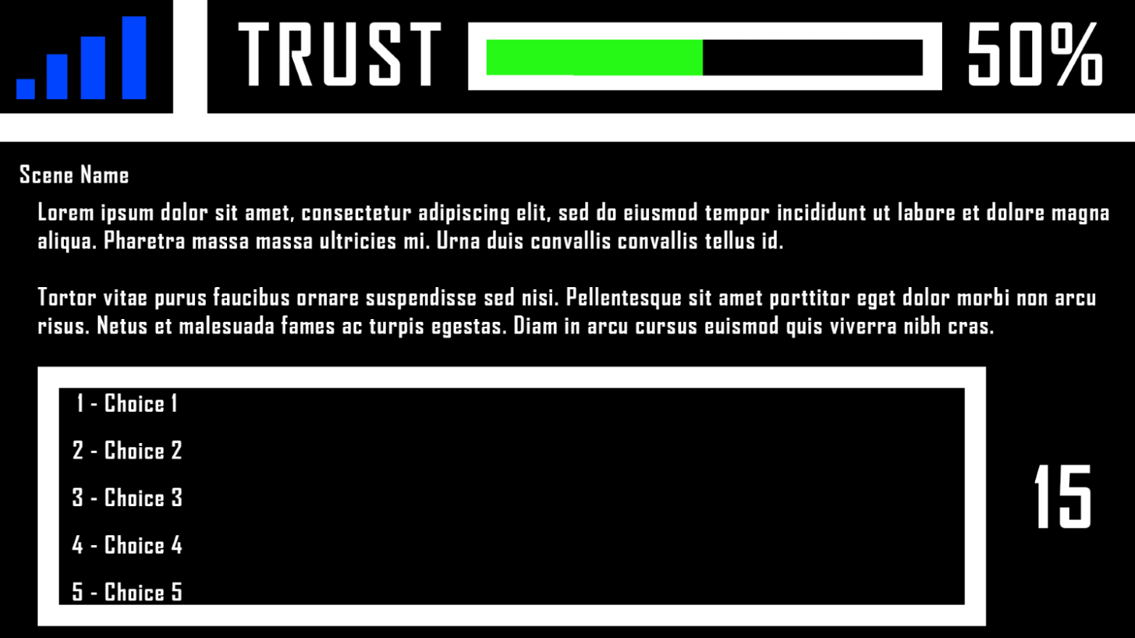
Problems Encountered
Game Interface v1 :
Game Interface v2 :
Problem of the menu on the right
(Text on the interface)
31/36

Slide 32
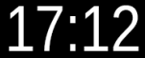
Problems Encountered
Timer :
Time :
Problem of the cursor
(Multiple changes on the interface at the same time)
32/36

Slide 33
Problems Encountered
Game Interface :
Glitched text :
Problem of the cursor & Difficulties
(Multiple changes on the interface at the same time)
33/36

Slide 34
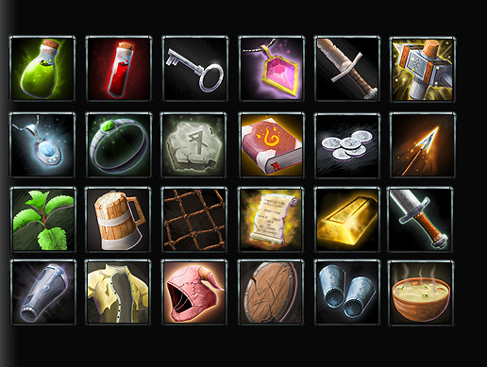

Problems Encountered
Inventory
Character State
Problem of Time
(Lack of time)
34/36

Slide 35
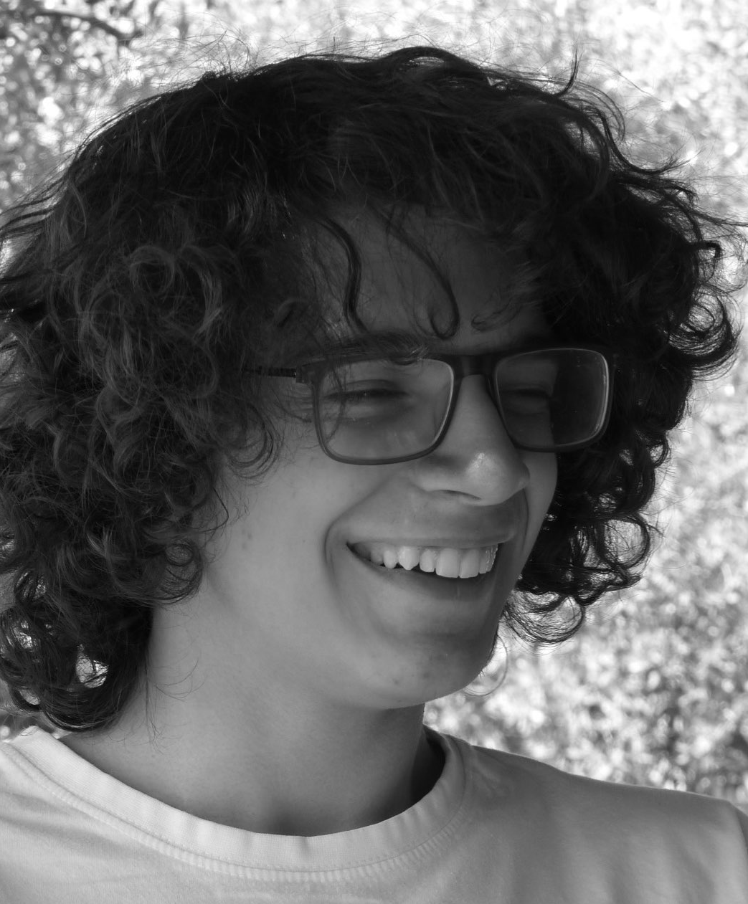
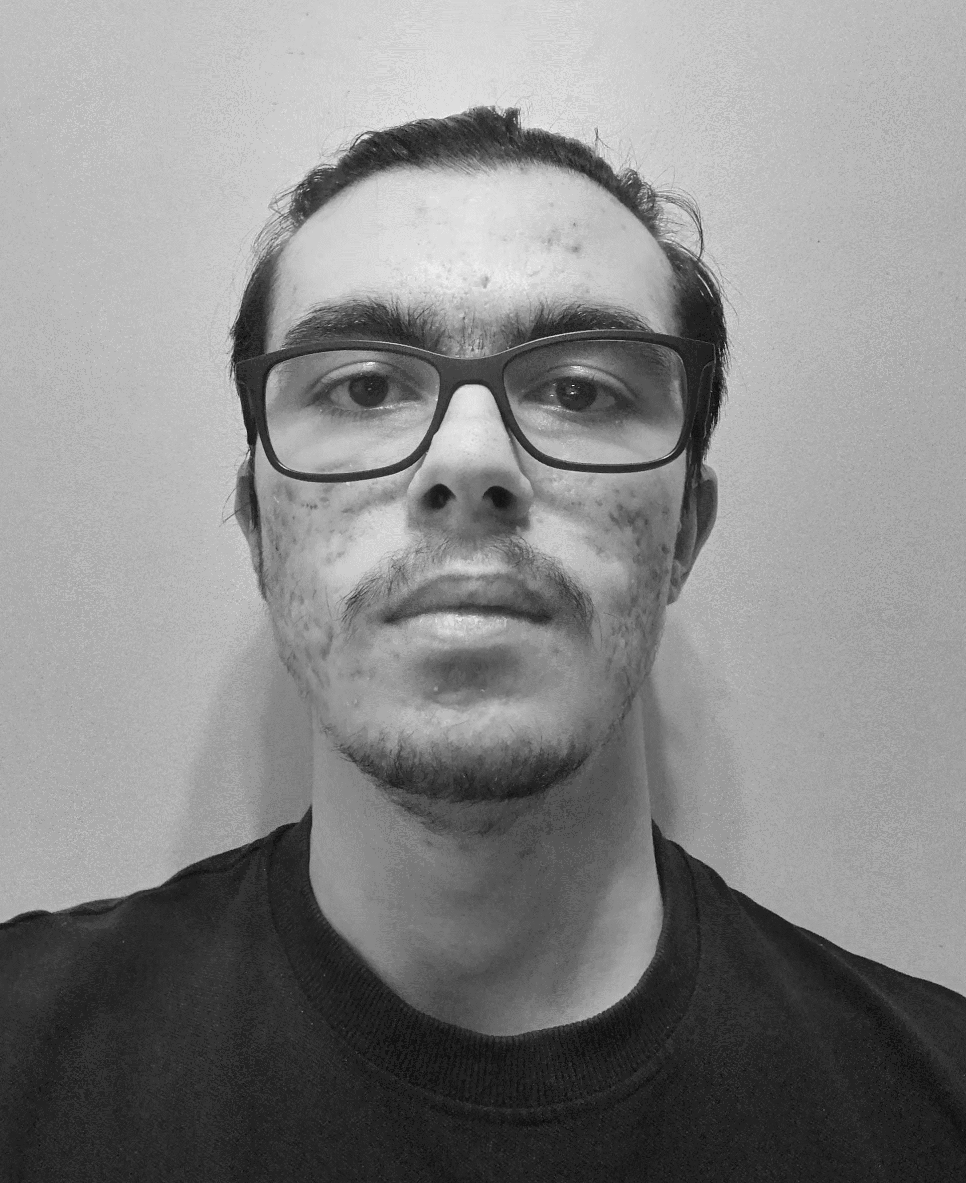
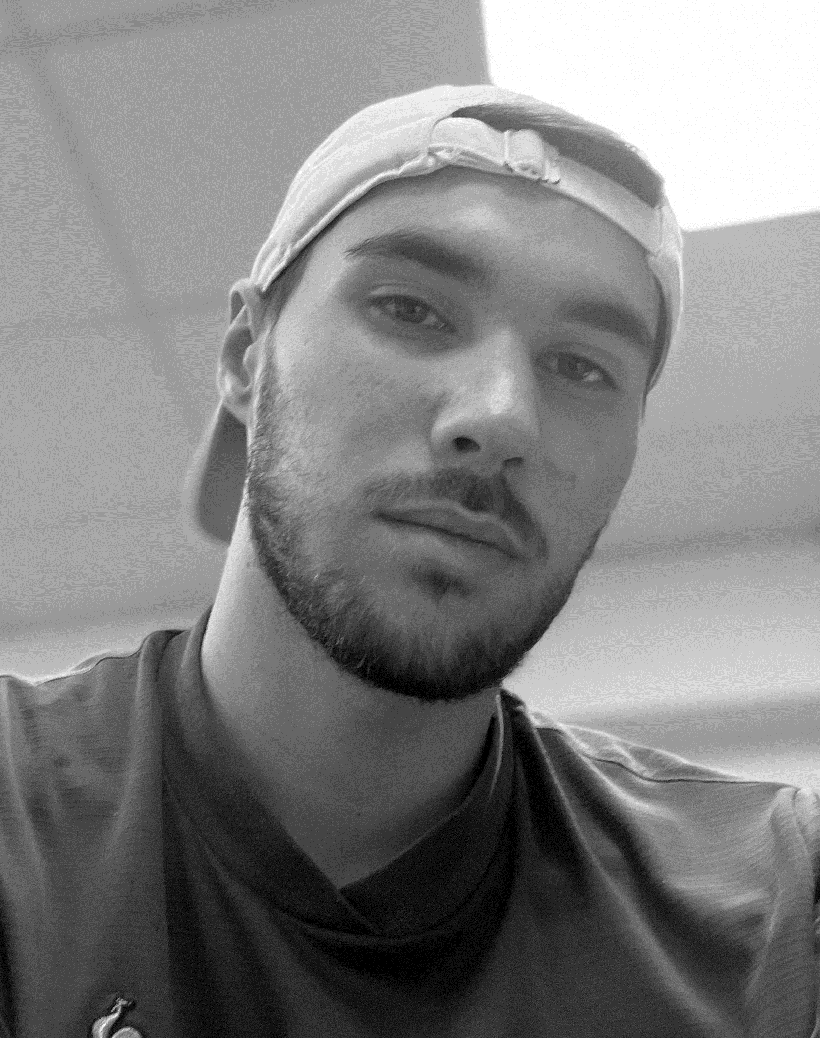
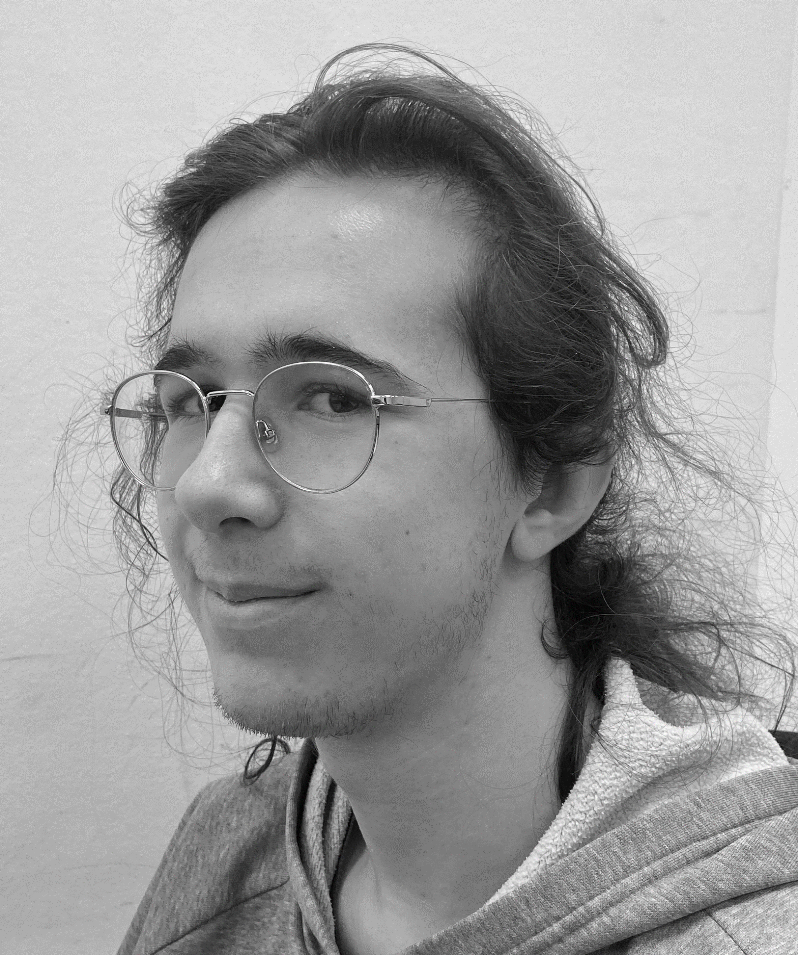
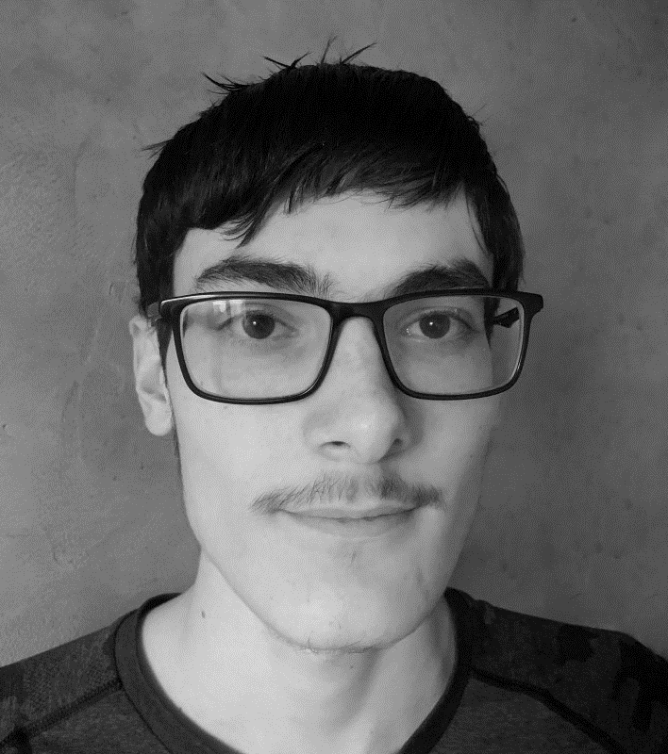

Team
Game Designers :
Game Programmers :
Florian
MARTINS
Baptiste
PERRIN
(Project Manager)
Adrien
LECHAT
Killian
FURNO
Loïc
VAREILLES
Hortense
MARIE
35/36

Slide 36
--SIGNAL LOST--
--SIGNAL LOST--
--SIGNAL LOST--
Thank you for your listening
Do you have any questions ?
36/36

Slide 37
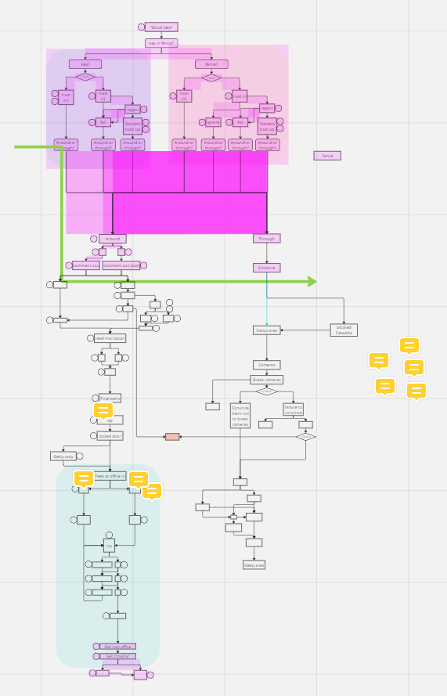
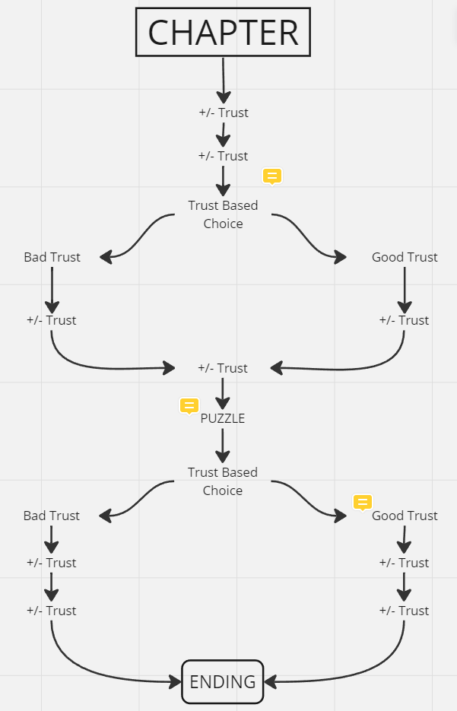
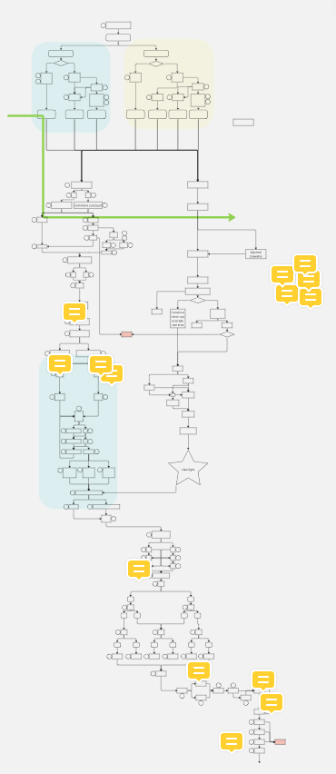
Annexes

Slide 38
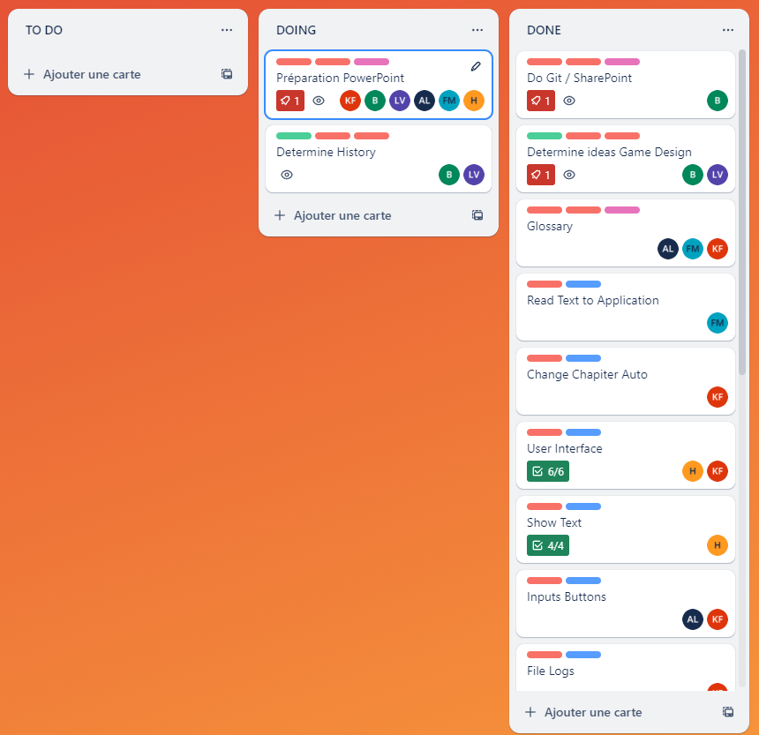
Annexes

